Slide 1
NORTH SOUTH UNIVERSITY
Lecture 08
PHI 104
Introduction to Ethics

Slide 2
Medical Ethics:
Drug Abuse
Euthanasia
Abortion

Slide 3
Medical Ethics

Slide 4
Medical ethics is the conduct required from any medical practitioner, it is necessary for the physician as it acts as a guide in making clinical decisions. Medical ethics is the ethical, morals and values aspect that guides the medical profession and its allies and it consists of interdisciplinary knowledge. It guides decision making, medical practice, medical education and research in medicine. There have been ethical guidelines which must be followed by healthcare workers in the history of the medical profession. In 1949, the international code of medical ethics has been adopted by the World Medical Association in London.

Slide 5
Every national medical board has a code of conduct to guides the practice of medicine in that country. For instance, in Bangladesh, medical ethics is governed by the Bangladesh Medical & Dental Council (BM & DC) which published a booklet titled ‘Code of Professional Conduct, Etiquette and Ethics’.

Slide 6
Medical ethics is a type of applied ethics. The basis of the medical ethics is centred on the Hippocratic Oath which is an oath is taken by every dental and medical graduate at the time of been inducted into the medical and dental profession. They are set of rules, regulations and guidelines that guides and governs physicians in carrying out their duties. Medical ethics focuses on the relationship that exists between the doctor and their patient, which includes the legal and ethical implications. Hospitals also ensure that their employees practice medical ethics to prevent litigations which can cause loss of resources to the health facilities.

Slide 7
Medical ethics is important in the practice of medicine therefore it is taught in most medical and dental schools both at the undergraduate and postgraduate levels. It is applied in all clinical settings as well as the medical workplace and in research; it encompasses other disciplines such as history, philosophy, theology, anthropology and sociology. It is the duty of every physician to practice medical ethics in every consultation with the patient.

Slide 8
Ideally, for a medical practice to be considered "ethical", it must respect four principles:
Autonomy (making decisions)
Justice (the burdens and benefits of new or experimental treatments must be distributed equally among all groups in
society)
Beneficence (the intent of doing good for the patient involved)
Non-maleficence (does not harm the patient involved)

Slide 9
Drug Abuse

Slide 10
What is Drug Abuse?
Drug abuse or substance abuse refers to the use of certain chemicals for the purpose of creating pleasurable effects on the brain. There are over 190 million drug abusers around the world and the problem has been increasing at alarming rates, especially among young adults under the age of 30. Apart from the long term damage to the body drug abuse causes, drug addicts who use needles are also at risk of contracting HIV and hepatitis B and C infections.

Slide 11
Causes of drug abuse
Drugs of abuse are usually psychoactive drugs that are used by people for various different reasons which may include:
Curiosity and peer pressure, especially among school children and young adults
The use of prescription drugs that were originally intended to target pain relief may have turned into recreational use and become addictive
Chemicals may be used as part of religious practices or rituals
Recreational purposes
As a means of obtaining false creative inspiration

Slide 12
Drug categories
Drugs of abuse fall into three groups and these include:
Depressants: These cause depression of the brain's faculties and examples include sleeping pills (barbiturates) and heroin.
Stimulants: These cause stimulation of the brain, giving rise to alertness and increased bursts of activity. A rapid heart rate, dilated pupils, raised blood pressure, nausea or vomiting and behavioral changes such as agitation, and impaired judgment may also result. In severe cases, there may be delusional psychosis which can occur with the use of cocaine and amphetamines.
Hallucinogens: These cause hallucinations and an "out of this world" feeling of dissociation from oneself. Hallucinogens may cause distorted sensory perception, delusion, paranoia and even depression. Examples include ecstasy, mescaline and LSD.

Slide 13
Examples of drug abuses
Alcohol
Tobacco
Cocaine from coca
Opium and opioids from poppy plants
Hashish or marijuana from cannabis
Synthetic drugs such as heroin, ecstasy and LSD

Slide 14
Epidemiology of drug abuse
Cannabis, marijuana and hashish are the most widely abused drugs in the world. Around 141 million people worldwide consume cannabis. The use of stimulants such as amphetamine and ecstasy is also widespread, with nearly 30 million people abusing these drugs. Cocaine is used by around 13 million people across the globe, with the highest number of users in the United States. Abuse of heroin and other opioids is less common than with other drugs and is taken up by around 8 million people worldwide, mainly in South-East and South-West Asia and Europe.

Slide 15
Drug abuse is seen in various different age groups and in individuals from nearly all walks of life and socioeconomic strata. However, men are more likely to abuse drugs than women, single people are more likely than married individuals and urban dwellers more likely than rural dwellers. Prisoners, street children and younger individuals are also more likely to abuse drugs.

Slide 16
Class Work
Ethics and Drug Abuse:
Individual Rights
vs
Human well being

Slide 17
End of life issues
Euthanasia

Slide 18
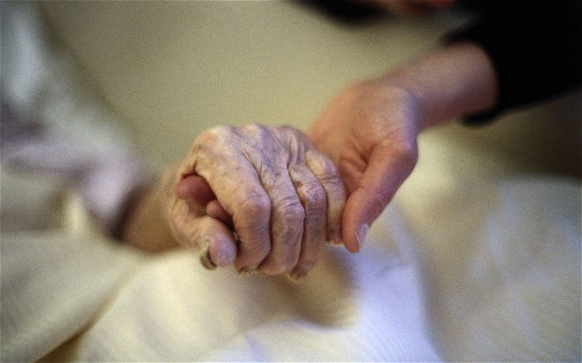

Slide 19
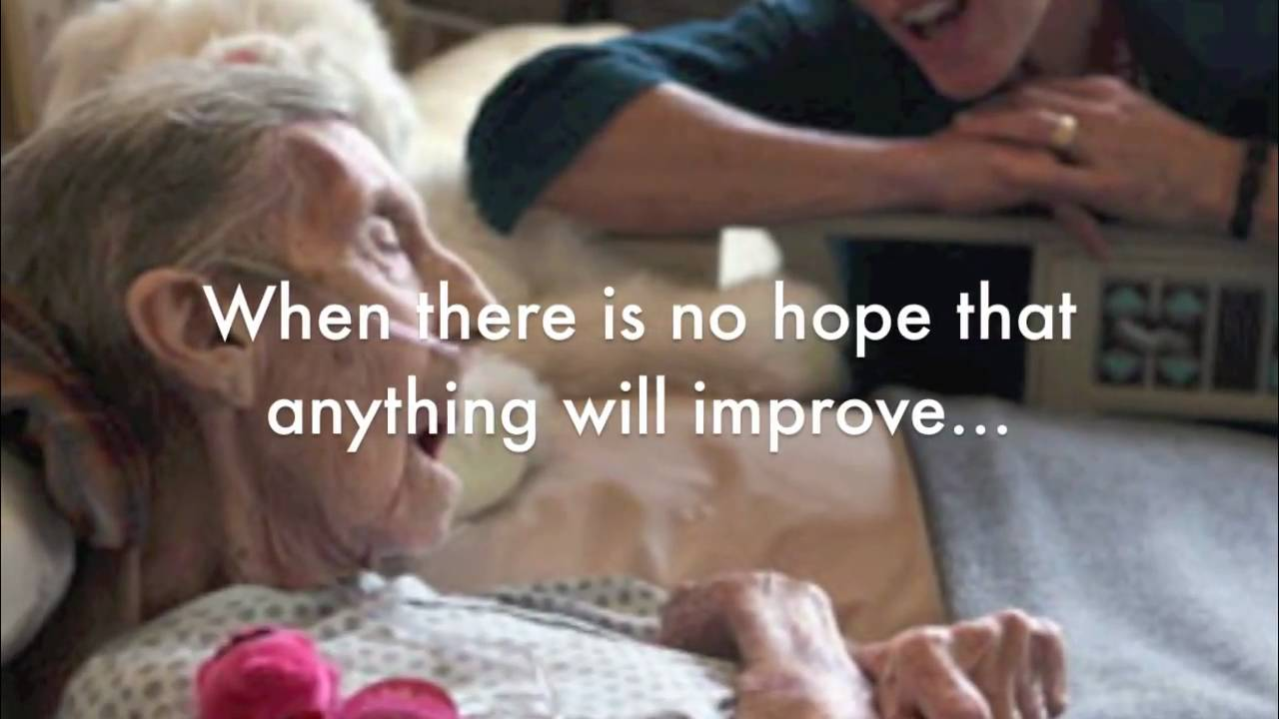

Slide 20
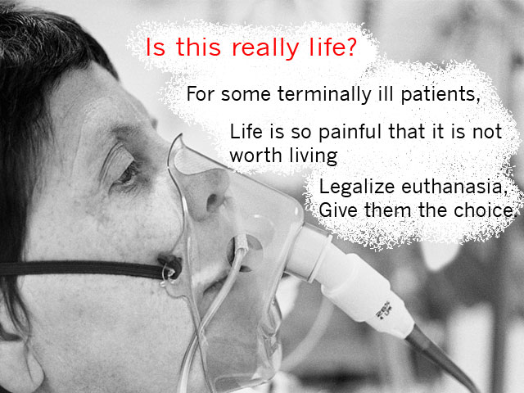

Slide 21
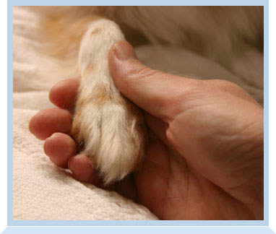

Slide 22
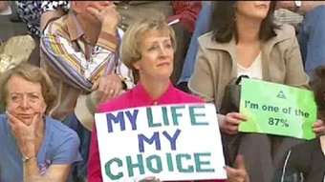

Slide 23
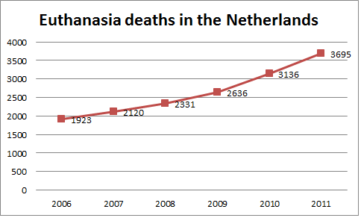

Slide 24
Euthanasia
Euthanasia is the act of deliberately ending a person's life to relieve suffering.
For example, a doctor who gives a patient with terminal cancer an overdose of muscle relaxants to end their life would be considered to have carried out euthanasia.

Slide 25
Assisted suicide is the act of deliberately assisting or encouraging another person to kill themselves.
If a relative of a person with a terminal illness were to obtain powerful sedatives, knowing that the person intended to take an overdose of sedatives to kill themselves, they may be considered to be assisting suicide.

Slide 26
English Law
Both active euthanasia and assisted suicide are illegal under English law.
Depending on the circumstances, euthanasia is regarded as either manslaughter or murder and is punishable by law, with a maximum penalty of up to life imprisonment.
Assisted suicide is illegal under the terms of the Suicide Act (1961) and is punishable by up to 14 years' imprisonment. Attempting to kill yourself is not a criminal act in itself.

Slide 27
Other countries
Active euthanasia is currently only legal in Belgium, Holland and Luxembourg. Under the laws in these countries, a person’s life can be deliberately ended by their doctor or other healthcare professional.
The person is usually given an overdose of muscle relaxants or sedatives. This causes a coma and then death.

Slide 28
However, euthanasia is only legal if the following three criteria are met:
The person has made an active and voluntary request to end their life.
It is thought that they have sufficient mental capacity to make an informed decision regarding their care.
It is agreed that the person is suffering unbearably and there is no prospect for an improvement in their condition.
Capacity is the ability to use and understand information to make a decision. Read more about the capacity to consent to treatment.

Slide 29
In some countries the law is less clear, with some forms of assisted suicide and passive euthanasia legal, but active euthanasia illegal.
For example, some types of assisted suicide and passive euthanasia are legal in Switzerland, Germany, Mexico and five American states.

Slide 30
Types of Euthanasia
Euthanasia can be classified in different ways, including:
active euthanasia – where a person deliberately intervenes to end someone’s life – for example, by injecting them with a large dose of sedatives
passive euthanasia – where a person causes death by withholding or withdrawing treatment that is necessary to maintain life, such as withholding antibiotics from someone with pneumonia.

Slide 31
Euthanasia can also be classified as:
voluntary euthanasia – where a person makes a conscious decision to die and asks for help to do this
non-voluntary euthanasia – where a person is unable to give their consent (for example, because they are in a coma or are severely brain damaged) and another person takes the decision on their behalf, often because the ill person previously expressed a wish for their life to be ended in such circumstances
involuntary euthanasia – where a person is killed against their expressed wishes

Slide 32
Depending on the circumstances, voluntary and non-voluntary euthanasia could be regarded as either voluntary manslaughter (where someone kills another person, but circumstances can partly justify their actions) or murder.
Involuntary euthanasia is almost always regarded as murder.
There are arguments used by both supporters and opponents of euthanasia and assisted suicide.

Slide 33
Next Lecture
Arguments for and against euthanasia and assisted suicide

Slide 34
Thanks
THANK YOU!!!

